Slide 1

Normalizing flow
22-808: Generative models Sharif University of Technology Fall 2024
Fatemeh Seyyedsalehi

Slide 2
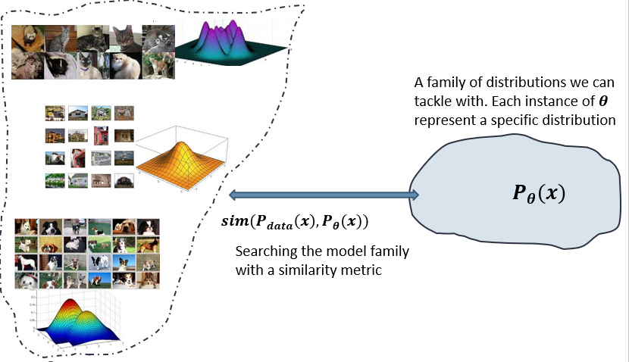
Recap
We need a framework to interact with distributions for statistical generative models.
Probabilistic generative models
Deep generative models
Autoregressive models
Variational Autoencoders
Generative adversarial networks
Normalizing Flow -> a latent variable model with tractable likelihood

Slide 3
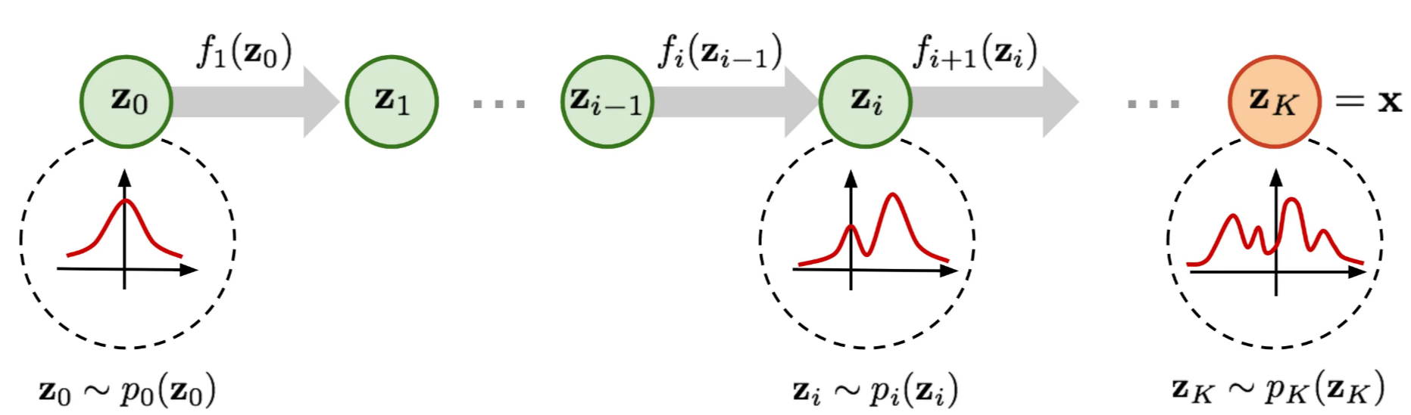
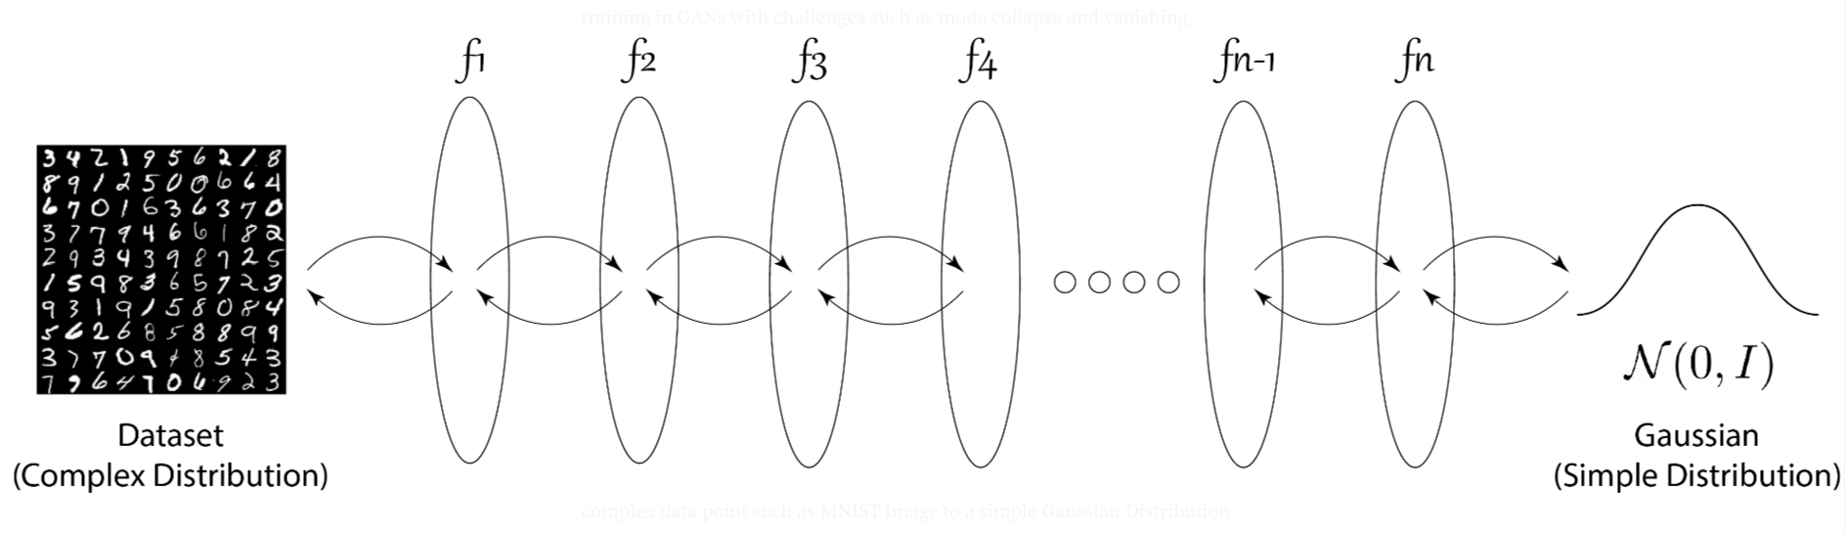
Motivation
Any two distributions can be converted to each other ☺
Start from a simple distribution and convert it to reach a sufficiently complex one to describe the data distribution
Find conversions with neural networks

Slide 4
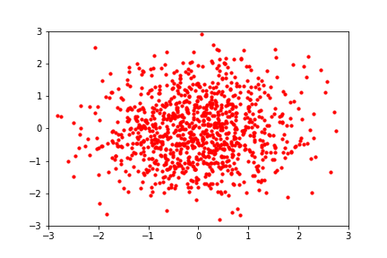
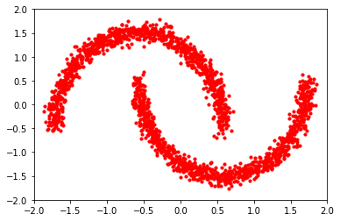
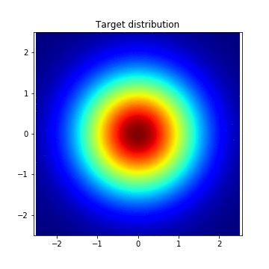
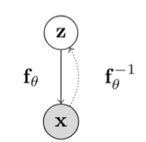
Motivation
Any two distributions can be converted to each other ☺

Slide 5
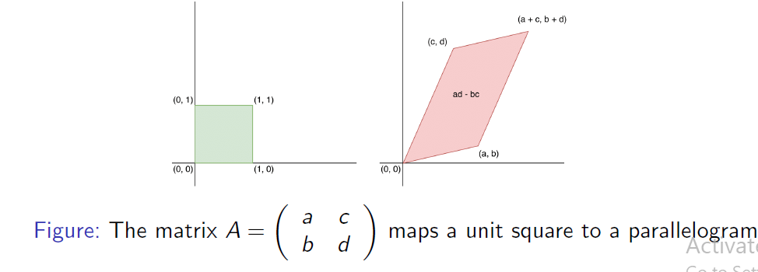
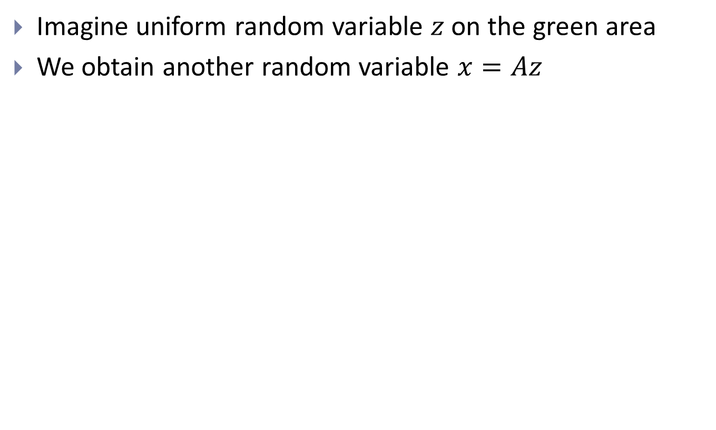
Change of variable formula
Imagine uniform random variable $z$ on the green area
We obtain another random variable $x=Az$

Slide 6
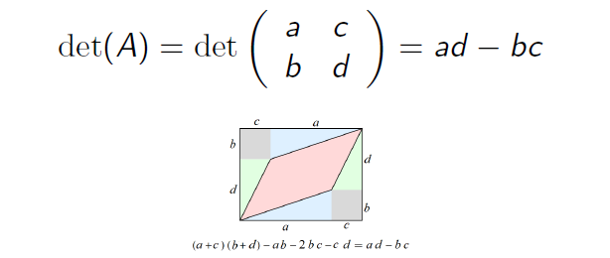
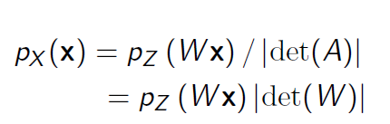
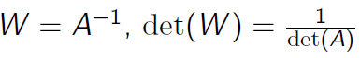
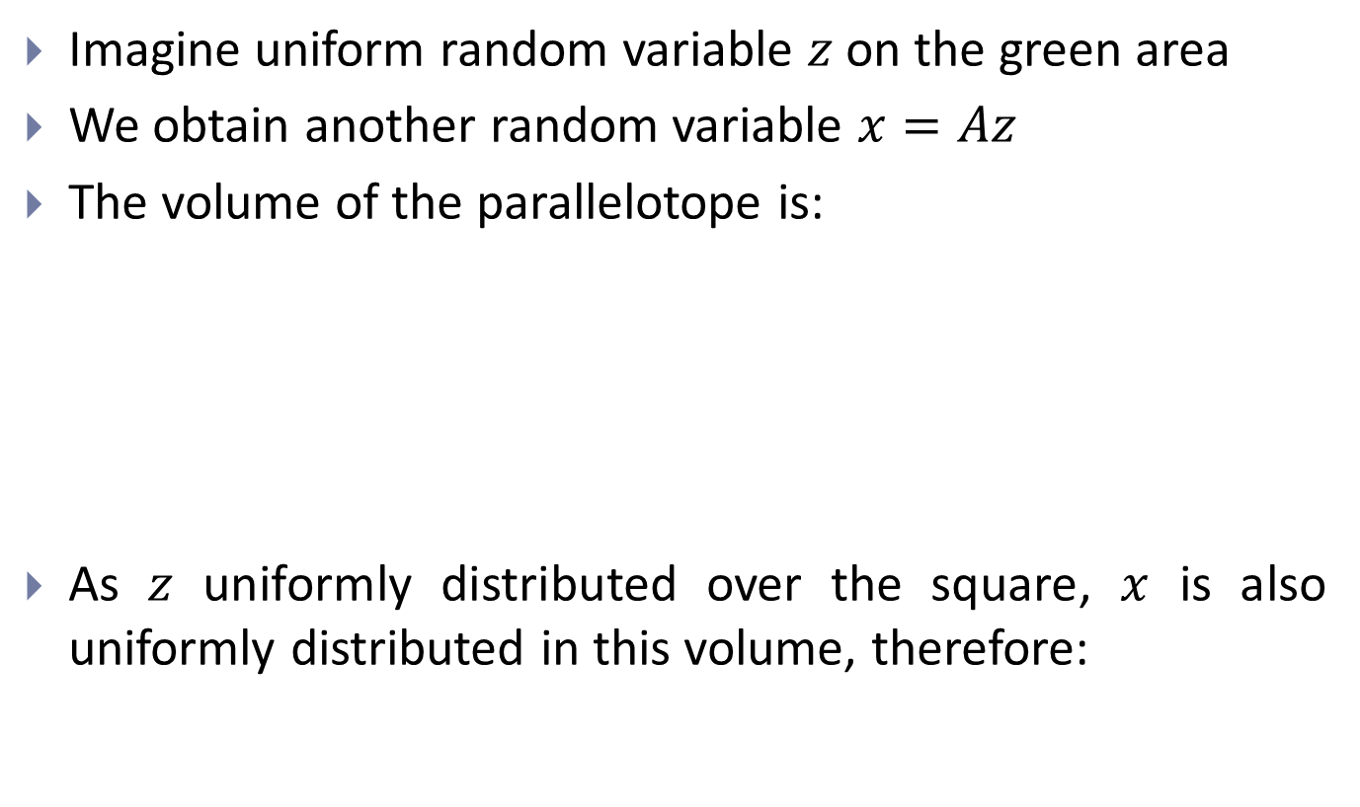
Change of variable formula
Imagine uniform random variable $z$ on the green area
We obtain another random variable $x=Az$
The volume of the parallelotope is:
As $z$ uniformly distributed over the square, $x$ is also uniformly distributed in this volume, therefore:

Slide 7
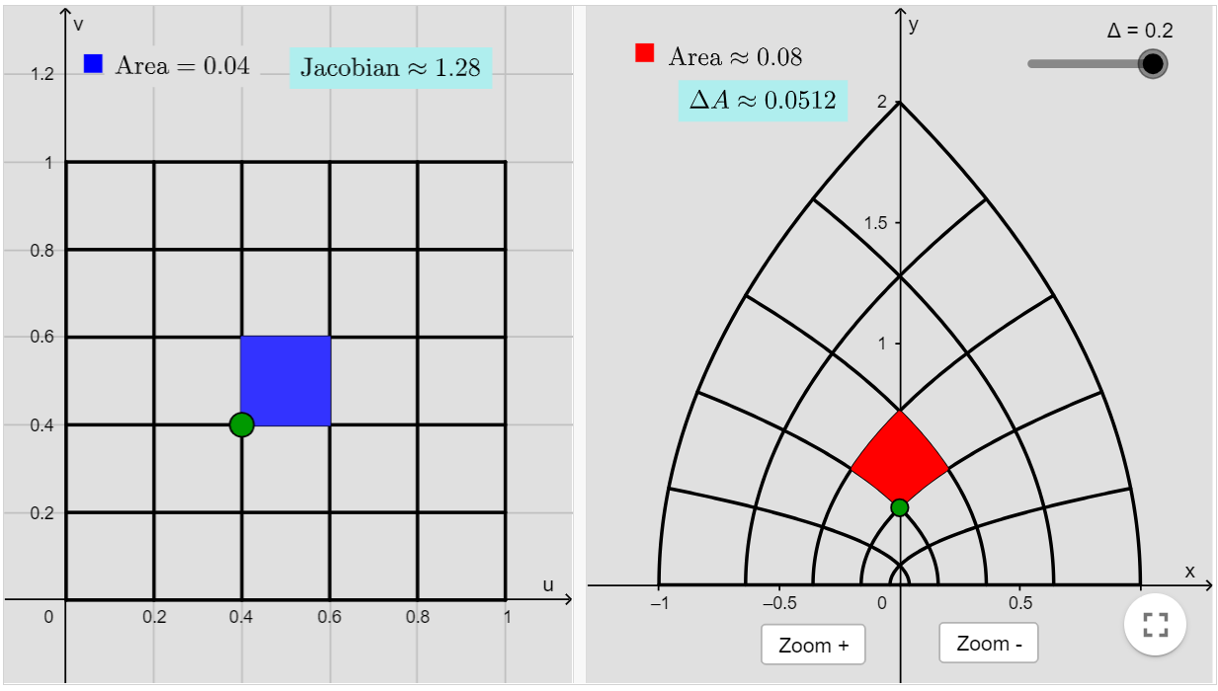
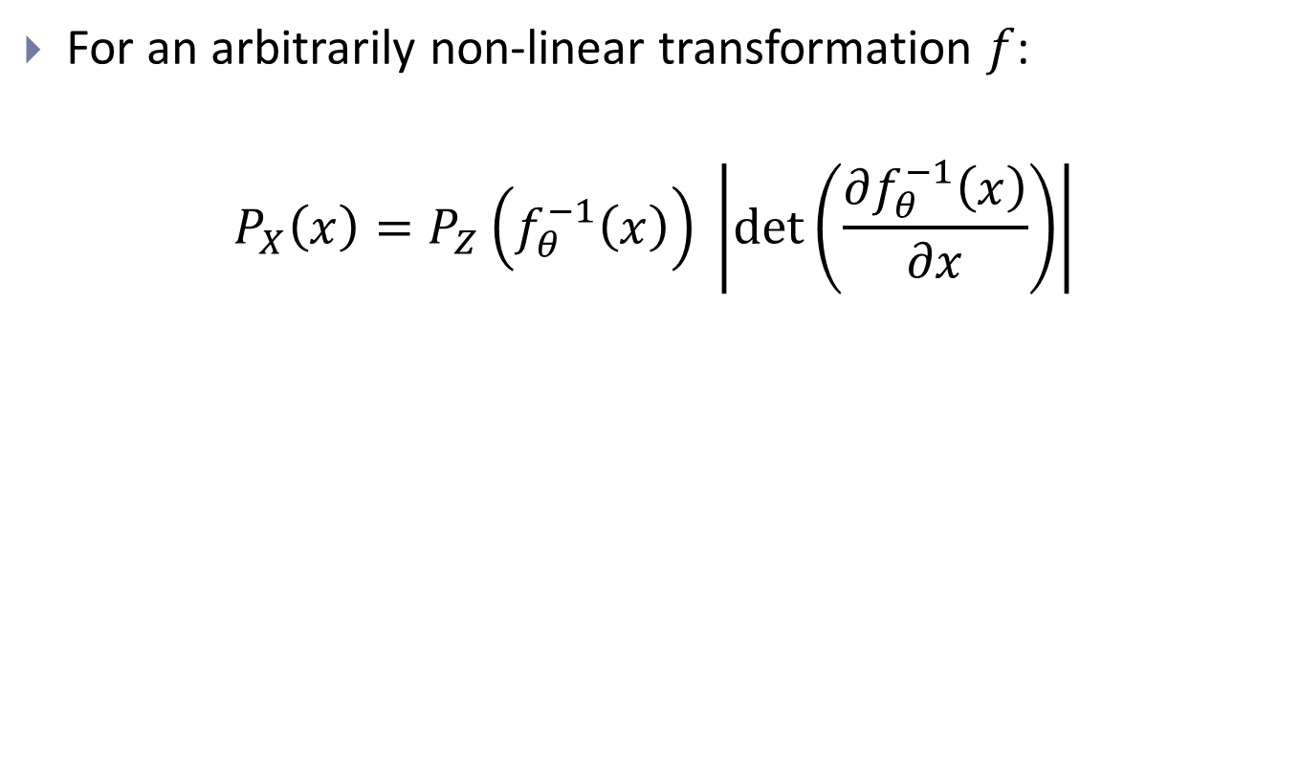
Generalized change of variable
For an arbitrarily non-linear transformation $f$:
$$P_{X}\left(x\right)=P_{Z}\left(f_{θ}^{−1}\left(x\right)\right) \left|\det\left(\frac{∂f_{θ}^{−1}\left(x\right)}{∂x}\right)\right|$$

Slide 8
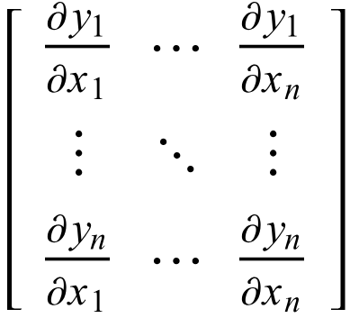
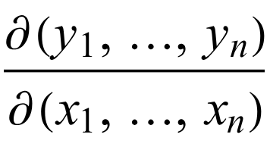
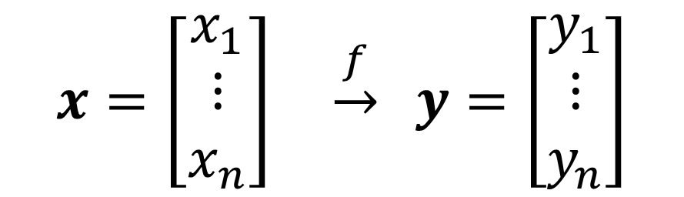
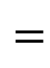
Jacobian matrix
$$x=\left[\begin{aligned}x_{1} \\ ⋮ \\ x_{n}\end{aligned}\right] \underset{→}{f} y=\left[\begin{aligned}y_{1} \\ ⋮ \\ y_{n}\end{aligned}\right]$$
$$=$$

Slide 9
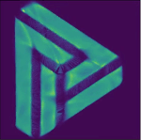
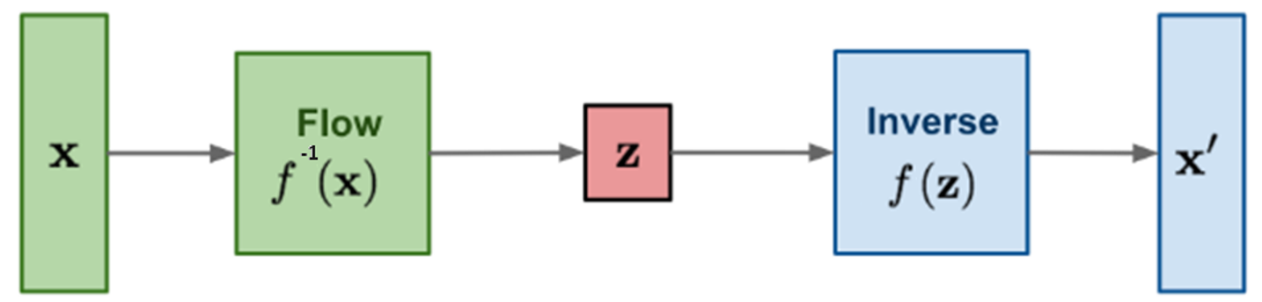
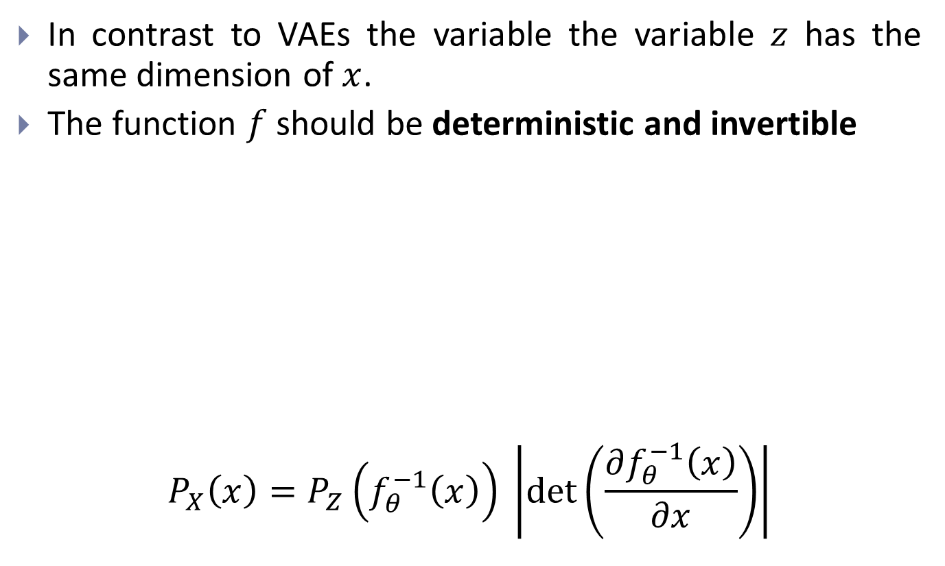
Normalizing flow
In contrast to VAEs the variable the variable $z$ has the same dimension of $x$.
The function $f$ should be deterministic and invertible
$$P_{X}\left(x\right)=P_{Z}\left(f_{θ}^{−1}\left(x\right)\right) \left|\det\left(\frac{∂f_{θ}^{−1}\left(x\right)}{∂x}\right)\right|$$

Slide 10
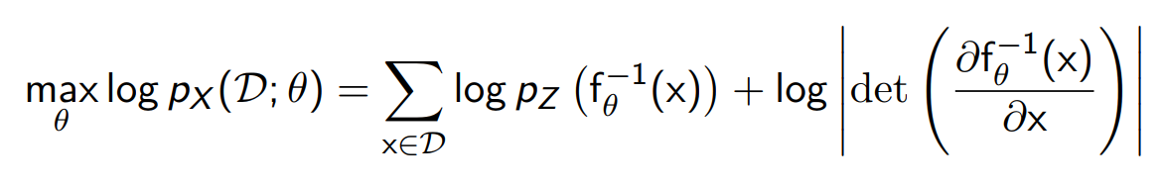
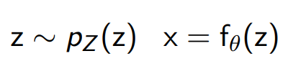
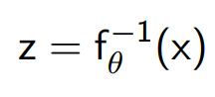
Learning and inference
Learning with maximum likelihood
Sampling
Latent representation

Slide 11
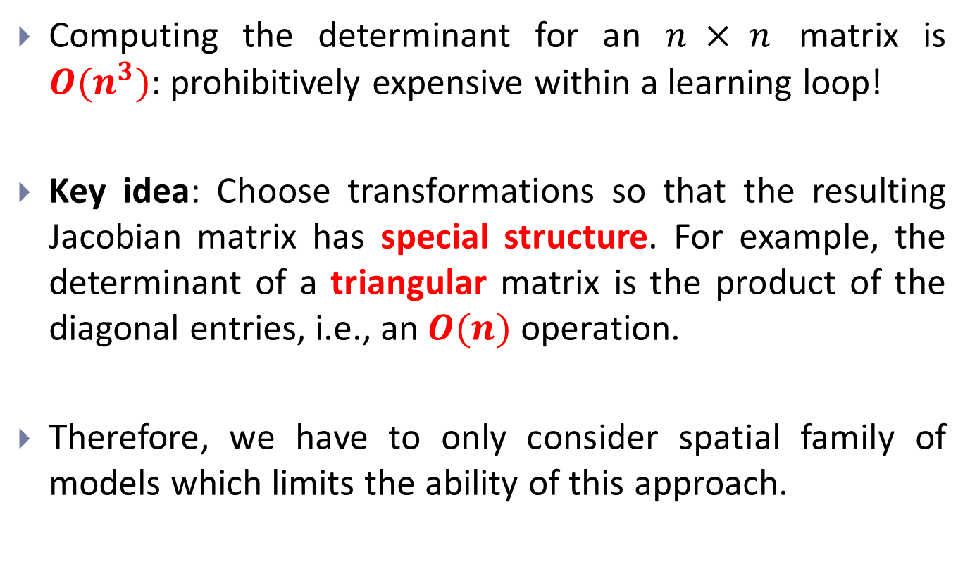
Learning and inference
Computing the determinant for an $n × n$ matrix is $O(n^{3})$: prohibitively expensive within a learning loop!
Key idea: Choose transformations so that the resulting Jacobian matrix has special structure. For example, the determinant of a triangular matrix is the product of the diagonal entries, i.e., an $O(n)$ operation.
Therefore, we have to only consider spatial family of models which limits the ability of this approach.

Slide 12
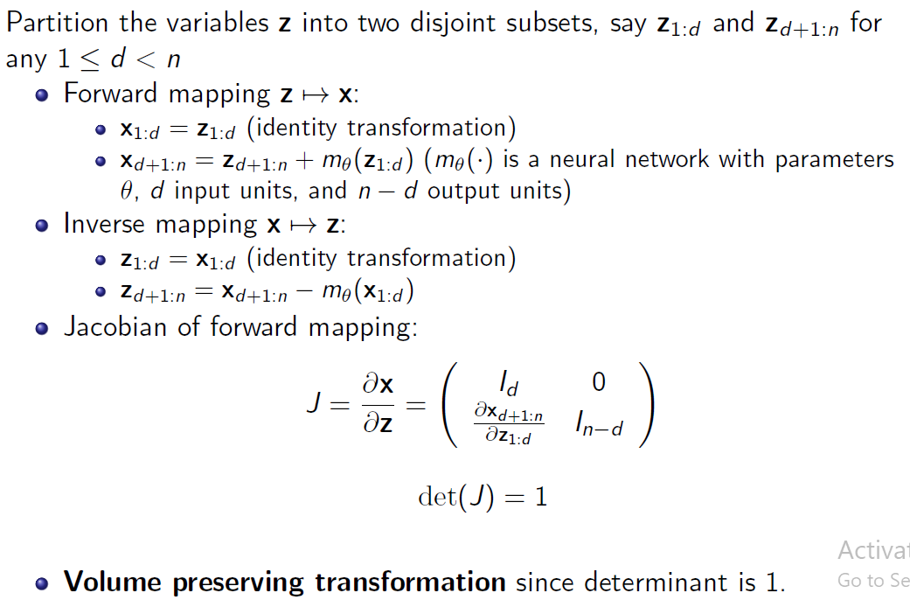
NICE - Additive coupling layers

Slide 13
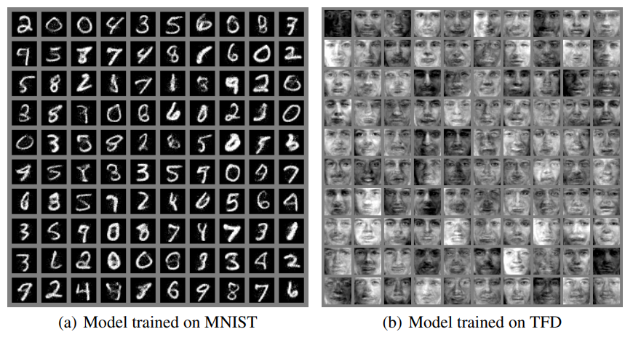
NICE - Additive coupling layers

Slide 14
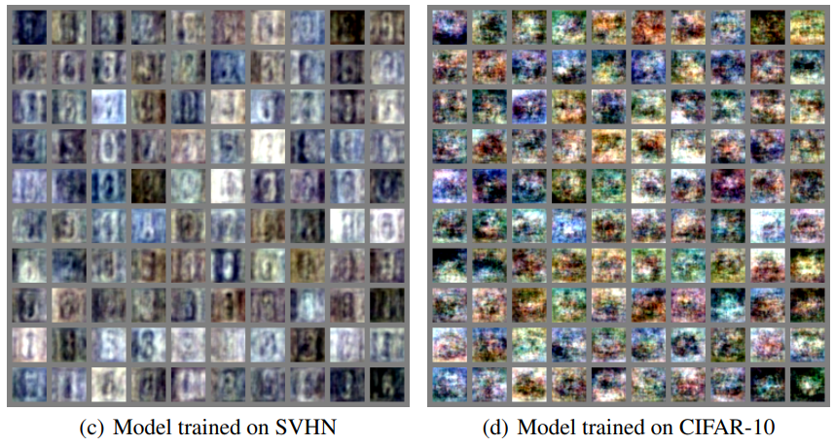
NICE - Additive coupling layers

Slide 15
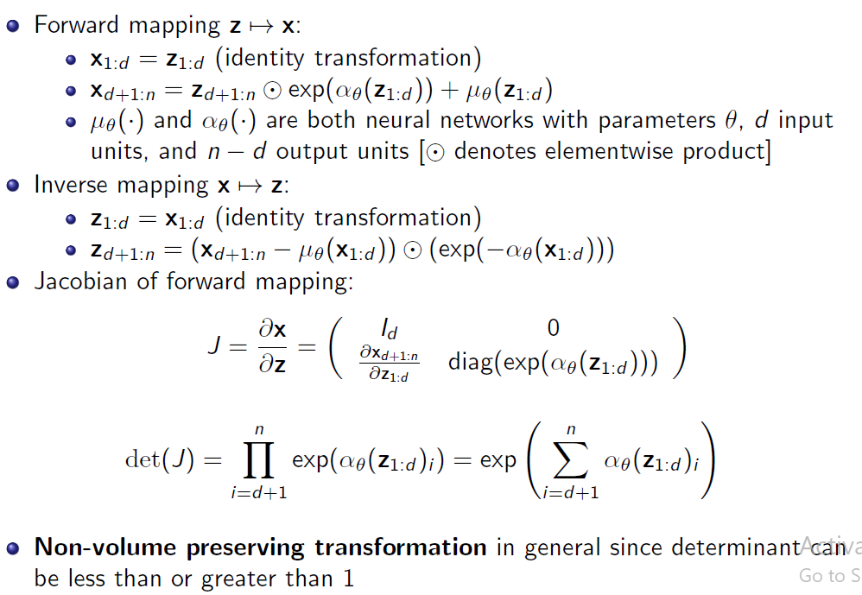
Real-NVP: Non-volume preserving extension of NICE

Slide 16
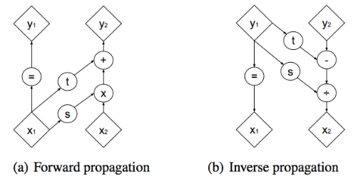
Real-NVP: Non-volume preserving extension of NICE

Slide 17
Real-NVP: Non-volume preserving extension of NICE

Slide 18
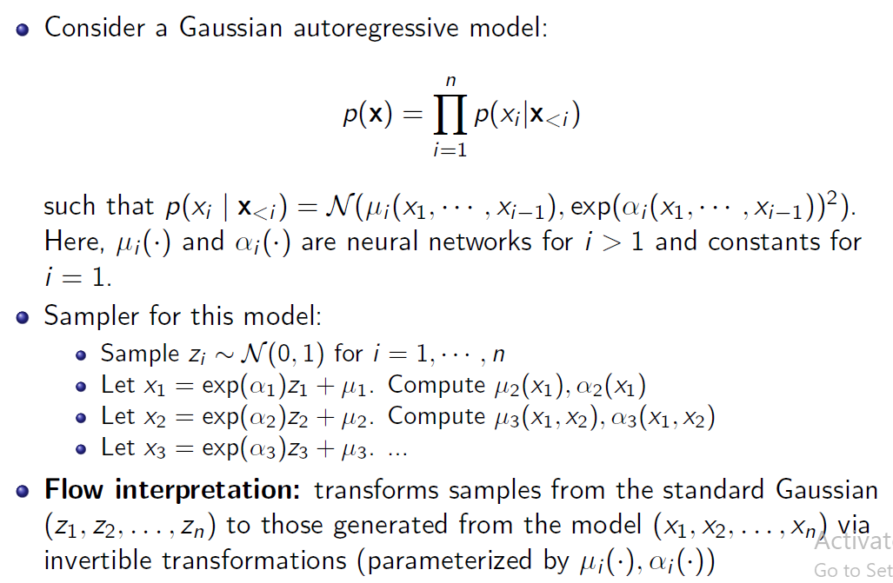
Continuous Autoregressive models as flow models

Slide 19
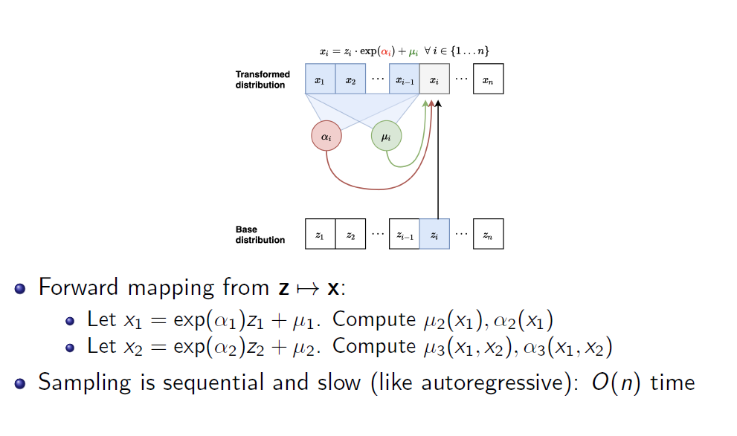
Masked Autoregressive Flow (MAF)

Slide 20
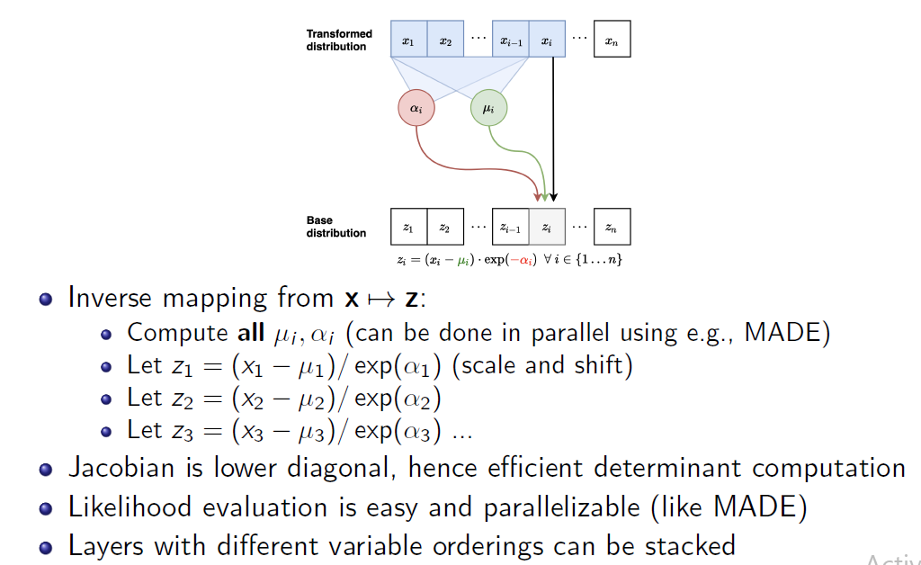
Masked Autoregressive Flow (MAF)

Slide 21
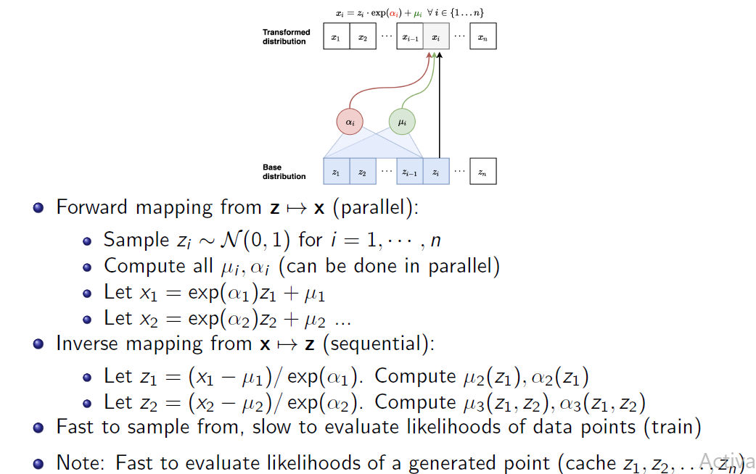
Inverse Autoregressive Flow (IAF)

Slide 22
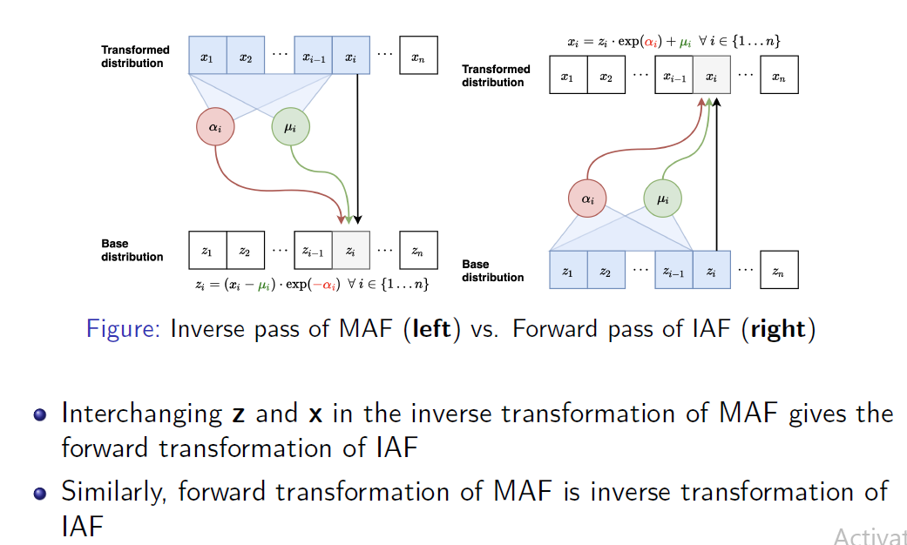
IAF vs. MAF

Slide 23
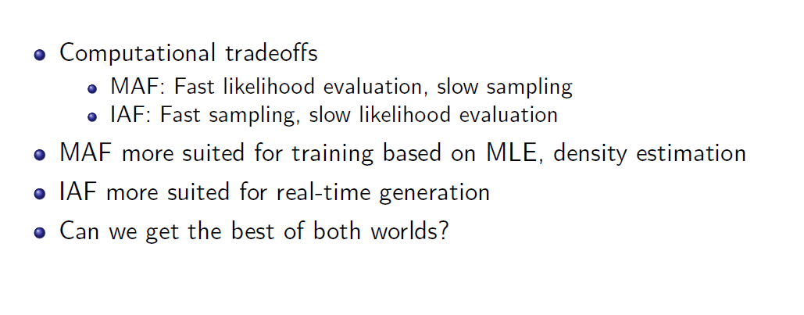
IAF vs. MAF

Slide 24
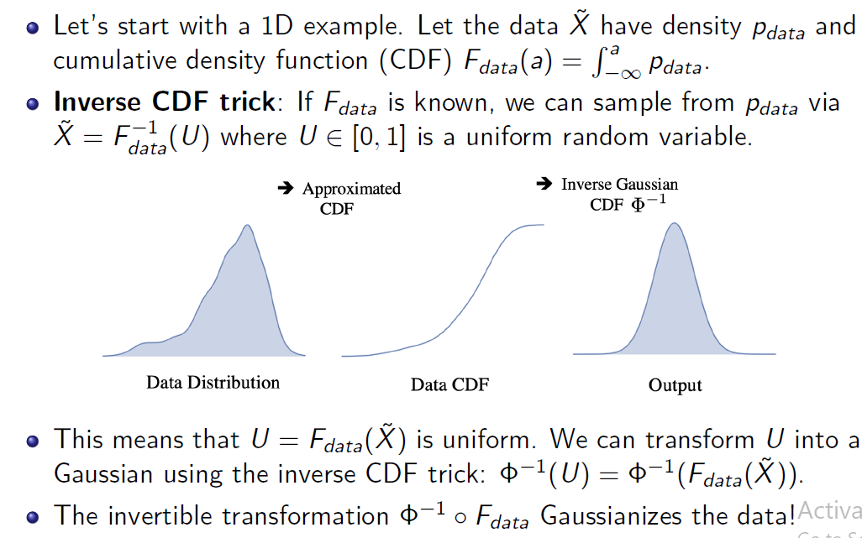
Gaussianization Flows

Slide 25
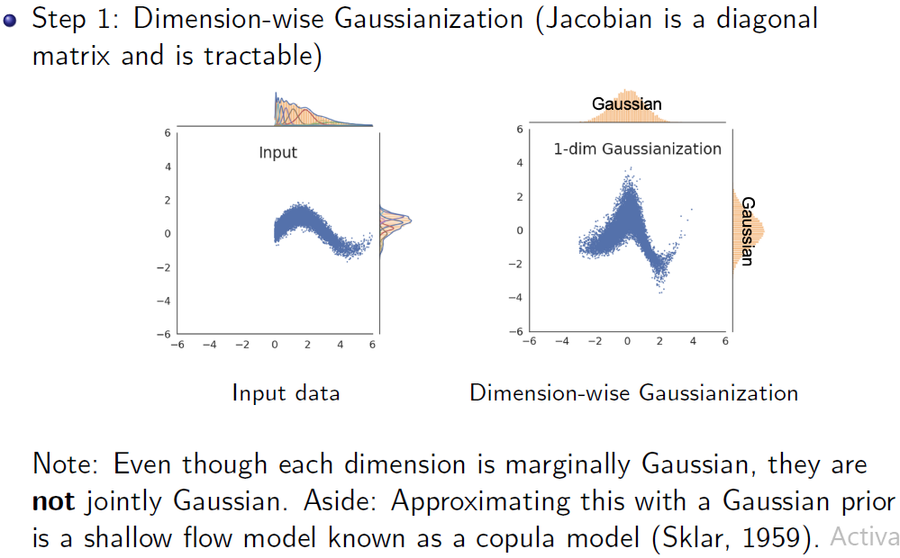
Gaussianization Flows

Slide 26
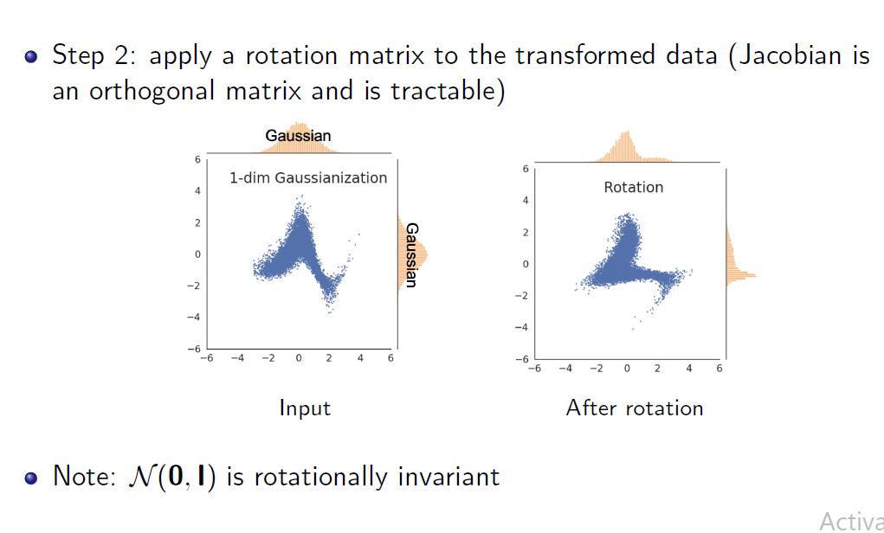
Gaussianization Flows

Slide 27
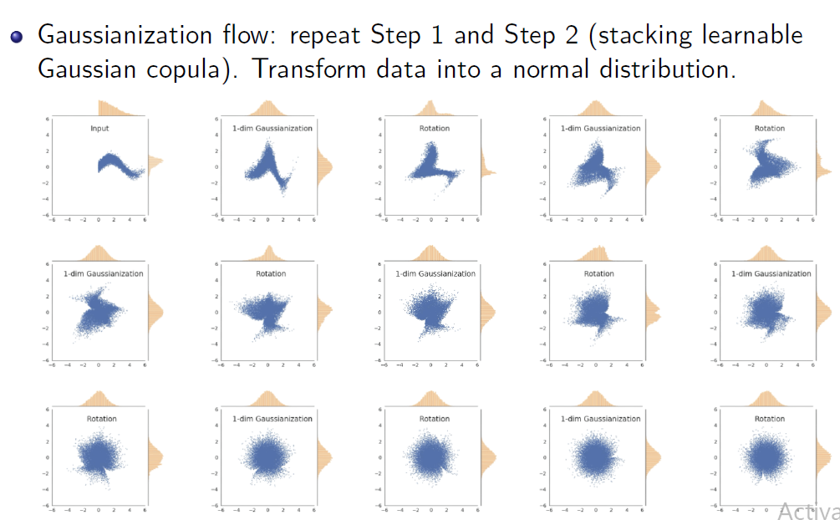
Gaussianization Flows

